Slide 1
PIP4004 - INTERNSHIP Review-0 Presentation Project Title: Design of a Privacy-preserving Mobile Wallet for Self Sovereign Identity Management
Student Details
Name | DYAMALLI K
Roll No | 20211CBC0046
Section | 8CBC-01
Batch No. | 9
Under the Supervision of,
Ms. Arshiya Lubna
Assistant Professor
School of Computer Science and Engineering
Presidency University
Name of the Program: CSE(BLOCKCHAIN)
Name of the HoD: Dr.Pravintha Raja
Name of the Program Project Coordinator: Ms. Suma NG
Name of the School Internship/Project Coordinators: Mr. Md Ziaur Rahman /
Dr. Sampath A K / Dr. Abdul Khadar A

Slide 2
Content
About Company or Organization
Working domain or the technology
About your team and reporting Manager
Challenges Faced in Internship
Objectives of the work
Internship Roadmap
Github Link

Slide 3
About Company or Organization
1. About the Company
RECTOPAGE Company
Founded in 2015
Headquartered in Bengaluru, India
Specializes in mobile and web application development
Over a decade of experience in the tech industry
2. Mission & Vision
Mission: Drive change through technology and innovation
Vision: Improve lives and businesses with progressive and innovative tech solutions

Slide 4
3. Key Achievements
Delivered numerous products
Served happy clients worldwide
Won multiple industry awards
Provided professional training to individuals in mobile and web app development
4. Products & Services
Web Applications – Custom full-stack applications
Mobile Applications – Native (Android/iOS) and Hybrid apps
Corporate Training – Training on trending tech topics

Slide 5
5. Clients & Market Presence
Global clientele across multiple industries
Worked on projects like Easy Gadgets, Art Circles, Photos to Art, Switch Art, Nexxus Engage, iQview, My Bills, Xfinity, Oscar, and Screen Bee
6. Contact Information
📧 Email: contact@rectopage.com
📞 Phone: +91 8073429502
📍 Address: #21 A, Krishna County Layout, Near Global Village Tech Park Front Gate, Bengaluru - 560068
🌐 Website: rectopage.com

Slide 6
Working domain or the technology
Working Domain : Web 3
Technology : React Native/Node JS

Slide 7
About your team and reporting Manager
Dr. Manoj Kumar
Principal Consultant at Recto Page
Expertise: Blockchain, Security, Identity Management
Role in this project: Guidance, strategy, and technical validation.
Team Composition:
Lead Developer: Mohit
Blockchain Engineer: Avinash
Mobile App Developer: Prachi
Security Expert: Manoj
Early-stage Responsibilities:
Research: Feasibility study, technology selection
Design: Initial system architecture and user flows

Slide 8
Challenges Faced in Internship
Finding an Internship: Competitive selection process
Cracking the Interview: Technical and HR rounds required extensive preparation
Adjusting to the Team: Adapting to company culture and collaboration dynamics
Learning Curve: Understanding blockchain, decentralized identity, and new tech stacks
Project Execution: Debugging, testing, and integrating various components efficiently

Slide 9
Litereture Survey
S.NO | Title | AUTHOR(S) | Year | Inference
1. | BLS-MT-ZKP: A Novel Approach to Selective Disclosure of Claims | Šeila Bećirović Ramić , | 2024 | Combines BLS signatures, Merkle Trees, and ZKP to enable privacy-preserving claim verification.
2. | A Self-Sovereign Identity Based on Zero-Knowledge Proof and Distributed Ledger Technology | Mohameden Dieye, Pierre Valiorgue, Jean-Patrick Gelas | 2023 | Proposes a blockchain-based SSI model using ZKP for identity authentication while preserving privacy.

Slide 10
S.NO | Title | Author(s) | Year | Inference
3. | Sign Up Wallet: A Blockchain and Machine Learning based Self-Sovereign Identity Model for Enhanced Digital Security. | Rani K, Vishnu Gomathi Sankar S, Vijay C | 2024 | Proposes a blockchain and ML-based identity wallet for enhanced digital security and fraud prevention.
4. | Designing Privacy-Preserving User Interfaces for SSI Wallets on Mobile Devices. | Moritz Teuschel, Daniela Pöhn. | 2024 | Focuses on user interface design for mobile SSI wallets with privacy-preserving features.
5. | A Taxonomy of Challenges for Self-Sovereign Identity Systems | Abylay Satybaldy, Md. SadekMariusz Nowostawski Ferdous. | 2024 | Identifies challenges in SSI, such as interoperability, scalability, and privacy concerns.
6. | A Self-Sovereign Identity Protocol With Anonymity and Accountability | Le Gao, Jiaxin Yu, Junzhe Zhang | 2024 | Introduces a balance between user anonymity and accountability in identity systems using ZKP.

Slide 11
Objectives of the work
To design a decentralized mobile wallet for managing Self-Sovereign Identity (SSI) securely.
To ensure privacy-preserving identity management using zero-knowledge proofs (ZKP) and selective disclosure mechanisms.
To provide a scalable and lightweight solution for mobile devices.
To enhance user control over personal identity data while ensuring security.
To integrate on-device authentication and Trust Chain-based verification to prevent identity fraud.

Slide 12
Proposed System / Work
3.1 System Architecture
Mobile Wallet App (User Interface for identity storage & sharing).
Trust Chain Network (for credential verification).
Issuer Module (Organizations issuing Verifiable Credentials).
Verifier Module (Entities verifying the user’s identity).
Privacy Layer (Implements ZKP and Selective Disclosure).

Slide 13
Proposed System / Work
3.2 Workflow
1. User Registration: Generates a Decentralized Identifier (DID).
2. Credential Issuance: An issuer grants Verifiable Credentials (VCs) to the wallet.
3. Authentication & Verification: Users authenticate via ZKP-based proof submission.
4. Selective Disclosure: Users share only required attributes for authentication.

Slide 14
Problem Statement
Current SSI solutions do not adequately address privacy concerns. Most trust-based identity wallets lack privacy-preserving mechanisms, exposing sensitive identity data. A lightweight, scalable, and privacy-preserving solution is required to enhance mobile identity management.

Slide 15
System Requirements
2 . Software Requirements
Mobile App: Flutter/React Native for UI.
Trust Chain Integration: Hyperledger Fabric (Smart Contracts).
Cryptographic Libraries: MIRACL for ZKP and Commitment Schemes.
Cloud/Edge Computing: Firebase for optional off-chain storage.
1. Hardware Requirements
Android/iOS smartphone (Samsung S23 Ultra, etc.).
Secure Element (for key storage).

Slide 16
Advantages of Proposed System/Work
Decentralized – Eliminates reliance on centralized identity providers.
Privacy-Preserving – Uses ZKP and selective disclosure to prevent unnecessary data exposure.
Scalable – Works efficiently on mobile devices with lightweight cryptographic computations.
Secure – Reduces identity fraud and replay attacks using a nonce-based commitment scheme.
User Control – Users retain full control over identity data and credential sharing.

Slide 17
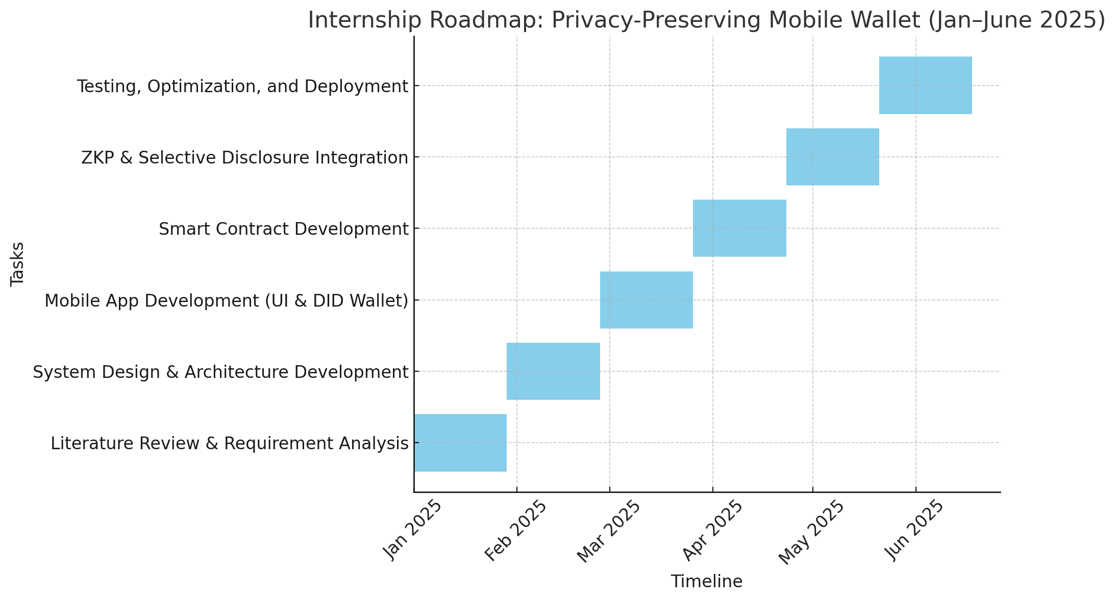
Internship Road Map
Note: Write in the below table what u will be achieving in each review

Slide 18
Github Link
Signed – NDA( Non Disclosure Agreement)

Slide 19
Q&A

Slide 20
Thank you !!

